Slide 1

HTML TAGS
Website design and development

Slide 2
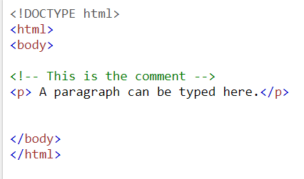
TAG(1) <!--...-->
This is the comment tag which has the purpose of inserting comments in the source code to describe and explain parts of the code.
Note: the comment will not be displayed on browser.

Slide 3
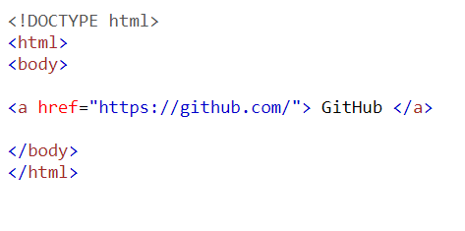

TAG(2) <a>
This tag is used to define a hyperlink, which is used to link from one page to another.
The attribute “href” should be used to identify the destination of the link (other page).
The links will be underlined and displayed according to its status:
If blue: this means the link hasn’t been opened (not clicked on)
If purple: this means the link has been opened (clicked on)
If red: this means the link is in active state

Slide 4
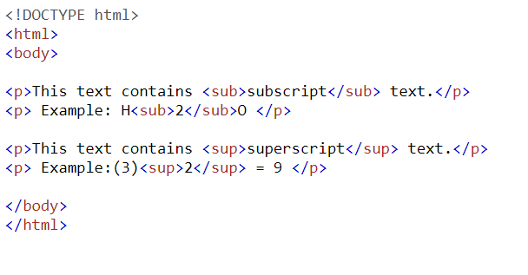
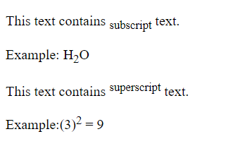
TAG(3) & TAG(4) <sub> & <sup>
The <sub> tag is used to create a subscript text (below the line)
The <sup> tag is used to create the superscript text (above the line)

Slide 5
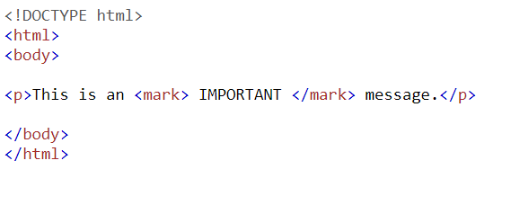
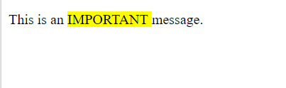
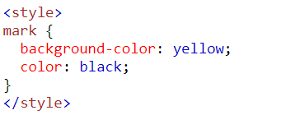
TAG(5) <mark>
This tag is used to highlight the text you want.
To choose a certain style, use this code:

Slide 6
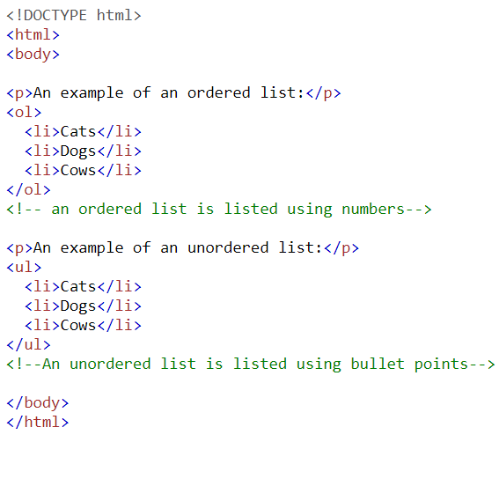
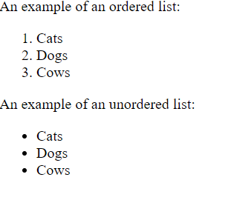
TAG(6) & TAG(7) & TAG(8) <li> & <ol> & <ul>
The <li> tag is used to define a list items.
This tag can be used in ordered (<ol>) lists and unordered lists (<ul>).

Slide 7
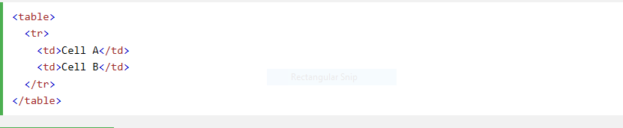
TAG(9) <td>
The <td> tag defines a standard cell in an HTML table.
An HTML table has two kinds of cells:
Header cells - contains header information (created with the <th> element)
Standard cells - contains data (created with the <td> element)
The text in <th> elements are bold and centered by default.
The text in <td> elements are regular and left-aligned by default.

Slide 8
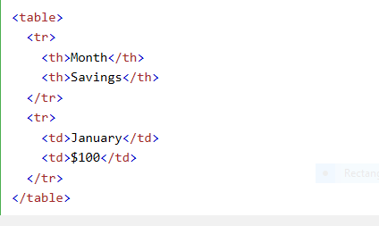
TAG(10)<table>
The <table> tag defines an HTML table.
An HTML table consists of the <table> element and one or more <tr>, <th>, and <td> elements.
The <tr> element defines a table row, the <th> element defines a table header, and the <td> element defines a table cell.

Slide 9
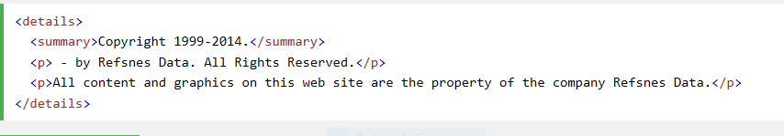
TAG(11)<summary>
The <summary> tag defines a visible heading for the <details> element. The heading can be clicked to view/hide the details.

Slide 10
TAG(12) <b>
The <b> tag specifies bold text without any extra importance.

Slide 11

TAG(13)<link>
The <link> tag defines a link between a document and an external resource.
The <link> tag is used to link to external style sheets.

Slide 12
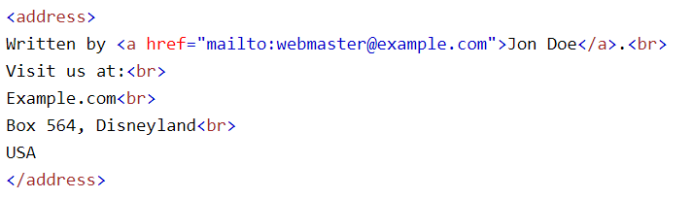
TAG(14)<address>
The <address> tag defines the contact information for the author/owner of a document or an article. The text in the <address> element usually renders in italic. Most browsers will add a line break before and after the address element. Tip: The <address> element will typically be included along with other information in a <footer> element.

Slide 13
TAG(15)<blockquote>
The <blockquote> tag specifies a section that is quoted from another source.
Tip: Use <q> for inline (short) quotations.

Slide 14

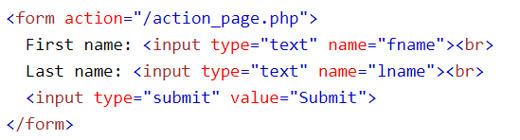
TAG(16)<button> & TAG(17) <input>
The <button> tag defines a clickable button.
Inside a <button> element you can put content, like text or images. This is the difference between this element and buttons created with the <input> element.
Note: If you use the <button> element in an HTML form, different browsers may submit different values. Use <input> to create buttons in an HTML form.
The <input> tag specifies an input field where the user can enter data.
<input> elements are used within a <form> element to declare input controls that allow users to input data.
An input field can vary in many ways, depending on the type attribute.

Slide 15
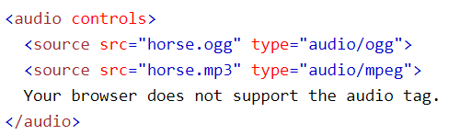
TAG(18)<audio>
The <audio> tag defines sound, such as music or other audio streams.
Currently, there are 3 supported file formats for the <audio> element: MP3, WAV, and OGG.

Slide 16
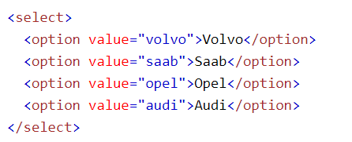
TAG(19)<option>
The <option> tag defines an option in a select list.
<option> elements go inside a <select> or <datalist> element.

Slide 17
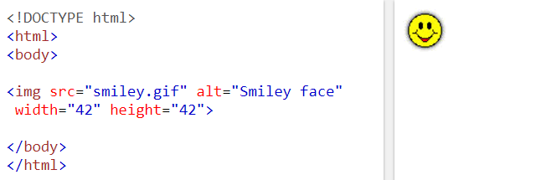
TAG(20) <img>
The <img> tag is used to display images.
The <img> tag has two required attributes: src and alt.
Note: images are linked to HTML pages not actually inserted.

